Slide 1
PART.1
Project Highlights:
User Friendly
Overview of the interface for data input and retrieval.
UPDATE THE QUANTITY OF MEDICAL SUPPLIES ALERT &
ALERT WHEN ITEMS ARE LOW
New Methods:
StockChecker::startChecking(): Initiates the inventory check feature, causing it to perform periodic checks.
StockChecker::stopChecking(): Halts the inventory check feature, pausing the check operation.
VINCENT AND KARINA
KARINA

Slide 2
PART.2
USER INTERFACE
Overview of the interface for data input and retrieval.
Forms for adding new supplies, updating quantities, and generating reports.
Accessibility features for ease of use.
User Interface

Slide 3
PART.3
RECORDING DATA
Code walkthrough for adding new supplies to the system.
Validation checks for data accuracy.
Handling exceptions and errors.
Recording Data

Slide 4
PART.3
UPDATING QUANTITY
Procedure for updating the quantity of medical supplies.
Real-time tracking and adjustments.
Automated notifications for low-stock items.

Slide 5
PART.3
REPORTING
Code implementation for generating inventory reports.
Customizable reports based on various parameters (e.g., by category, supplier).
Exporting options for external use.

Slide 6

PART.4
Introduction to the Inventory Check Feature:
INTRODUCTION
The inventory check feature is designed to monitor the real-time stock levels of a specific item and trigger an alert when the stock falls below a set threshold. To implement this functionality, the StockChecker class and related methods have been introduced.
VINCENT

Slide 7
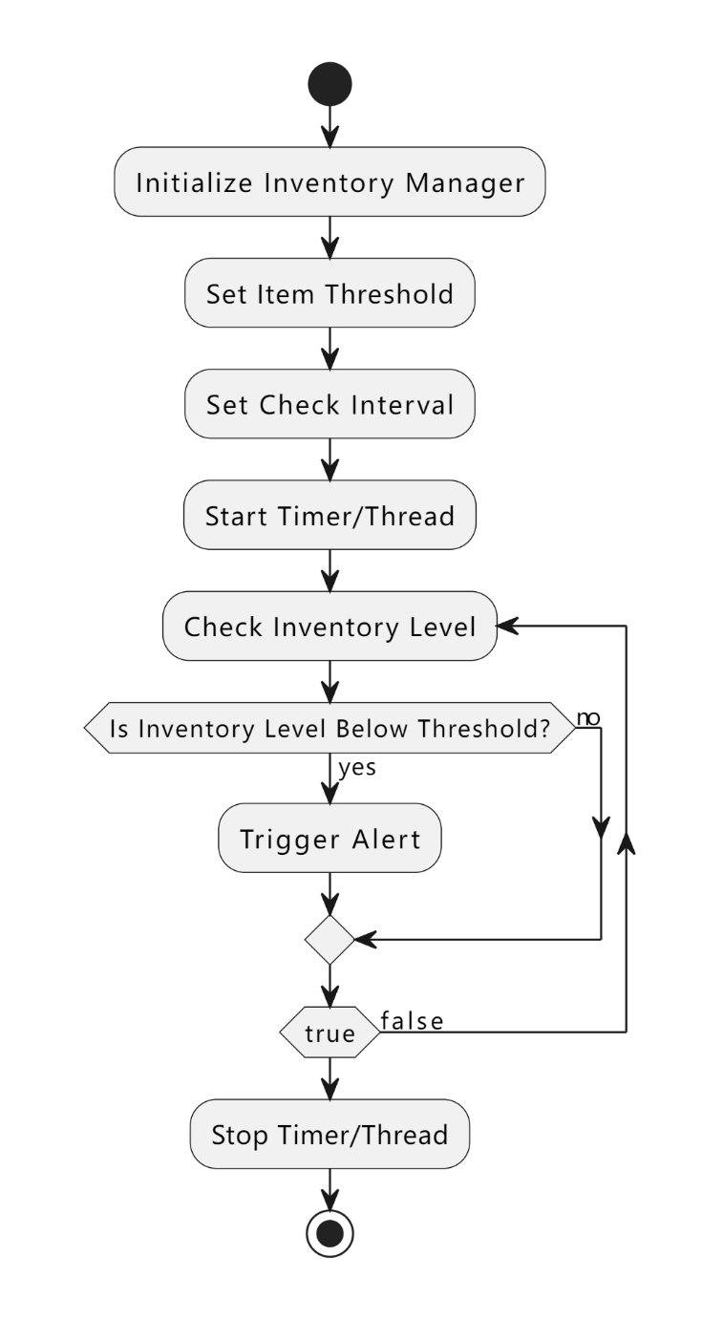
PART.4
NEW CLASS: StockChecker
CREATE CLASS TO EXCUTE STOCK CHECK
StockChecker Class:
The StockChecker class is responsible for periodically checking the stock levels of a specific item.
It utilizes mechanisms such as timers or threads to ensure that the check operation is executed at set intervals.
New Methods:
StockChecker::startChecking(): Initiates the inventory check feature, causing it to perform periodic checks.
StockChecker::stopChecking(): Halts the inventory check feature, pausing the check operation.

Slide 8
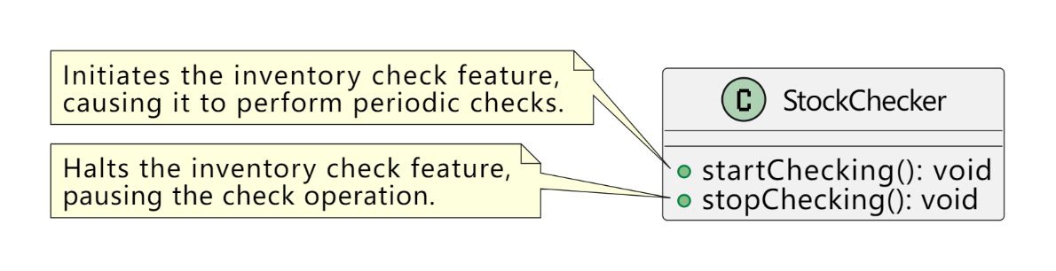
PART.5
METHOD
METHOD AND USAGE
Method Descriptions:
The StockChecker::startChecking() method initiates a timer or thread in the background, calling the check method at specified intervals.
The StockChecker::stopChecking() method stops the timer or thread, temporarily suspending the inventory check feature.
Usage Example:
InventoryManager inventoryManager;
inventoryManager.addItem("vaccine", 50);
StockChecker stockChecker(inventoryManager, "vaccine", 10);
stockChecker.startChecking(); // Start the inventory check feature
PPT模板 http://www.YPPPT.com/moban/

Slide 9
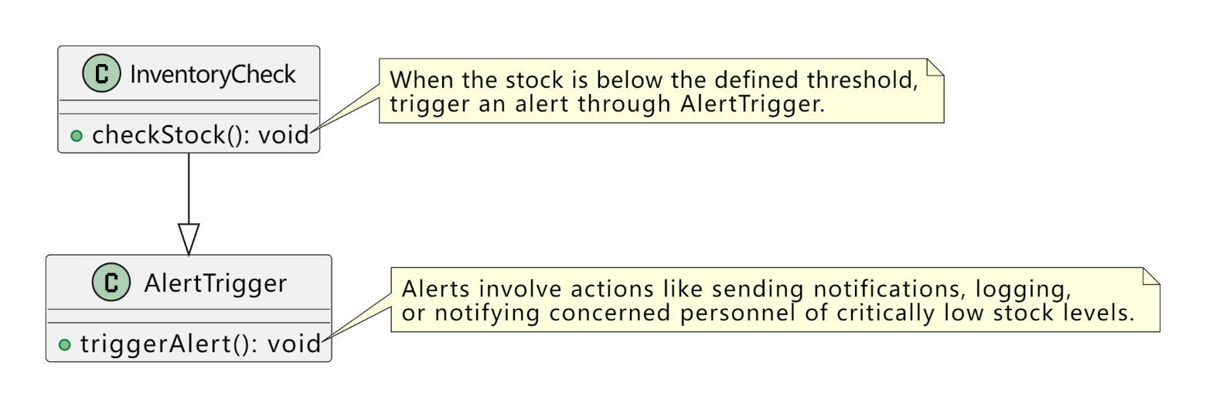
PART.6
ALERT LOGIC
ALERT TRIGGER LOGIC:
When the check identifies that the stock is below the defined threshold, the inventory check feature triggers an alert.
Alerts can involve actions such as sending notifications, logging, or other relevant operations to notify concerned personnel of critically low stock levels.
Notes:
https://www.ypppt.com/

Slide 10
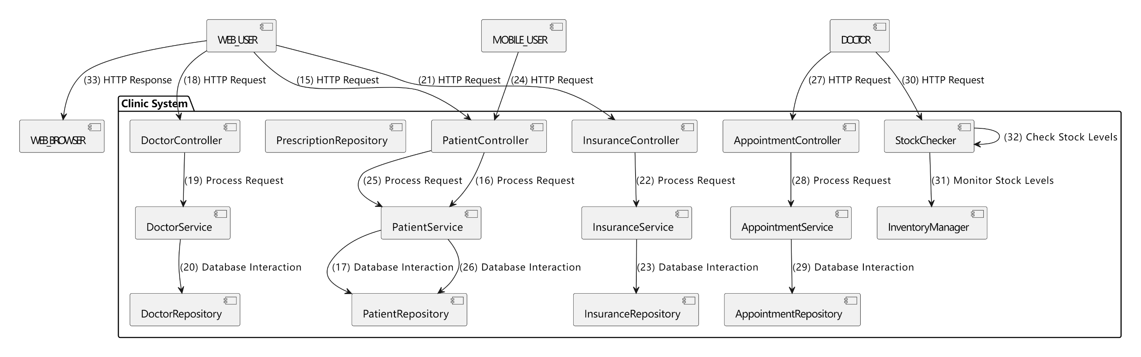
PART.7
SYSTEM LOGIC
Notes:
https://www.ypppt.com/

Slide 11





THANK YOU FOR WATCHING
KARINA AND VINCENT

